Slide 1
Financial Training for School Administrators
Kathy Hanlon
Arkansas Public School Resource Center

Slide 2
How many have a program?
Is it a state program?
An Association program?
How about a district program?
Who is it for?

Slide 3
Association Programs
What we do in Arkansas
Tier training
Required by state law
A joint effort from AASBO and the Dept. of Ed
12 hours initially and 2 hours annually
Certification Classes
Presentations at Joint
Administrator Conferences

Slide 4
District Programs
New Administrators
Including a new superintendent
Aspiring Administrators
Current Administrators
Directors, Admin. Assistants, and the rest of the folks who take care of business
Periodic tune-ups

Slide 5
What Would I Have Liked to Know?

Slide 6
New Administrators
New Administrator Orientation (larger scale)
Bring all Departments, share what they do.
Share culture
Is food OK?
Travel
Other norms, dress, board meetings
Specifics
What do they do from their level
What does the district take care of
Laws/Rules/procedures
Bids, quotes, gift cards
Cash handling, receipts
Allowable expenditures

Slide 7
New Administrators (small scale)
Same stuff –only a bit more personal
Introduce them to folks
Share culture and norms
Rules/laws/procedures
Cash handling
Building responsibilities vs district
Can they alter building, paint
Donations

Slide 8
Where is the quicksand?

Slide 9
New Superintendents
Ask what they need from you
Be southern
I’m sure you know but would you like a refresher on…
Basics
Budget
Funding
Debt
Average Salary
Average Class size

Slide 10
More New Superintendent
Don’t overload them
How do they like to get info?
District Norms
Budget timeline
Board financial reporting
Don’t over share
Let them take the lead

Slide 11
Aspiring Administrators

Slide 12
Aspiring Administrators
Build Your Program
Identify what you want in an Administrator
Who can teach what?
Pick your passion
Help find their passion
Collaborate

Slide 13
Aspiring Administrators
Identify potential
Ask principals
Ask who is interested
What are their goals?
What would they like to help with?
Don’t pay them

Slide 14
Aspiring Administrators
Finish with a project
They need to be able to practice
Gathering data
Analyzing
Colaborating
Presenting
You have lots of needs they can help with
New policy
New procedures
Facilities needs
The possibilities are endless

Slide 15
Sample Projects
Grade configuration
New scheduling procedures/duty schedules
Meaningful PD
Best teaching practices
On-line resource sharing
Implementation of a new program
Public outreach
Better communication
Staff recognition programs

Slide 16
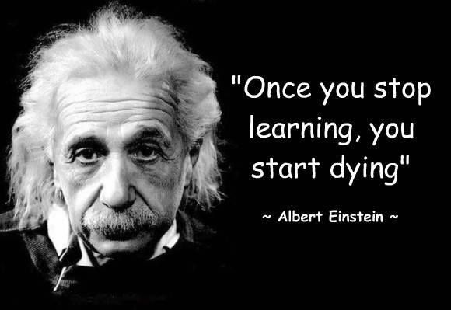
Current Staff

Slide 17
Current Staff

Slide 18
Current Staff Ideas
Principals, Assistant Principals and Directors
Short sessions at regular meetings
Ask what they would like to know more about
Assistant Principal Academy
Go over the budget
Address problem areas
Ask
What’s not working
What can we make easier
What is frustrating you

Slide 19
Current Staff Admin Assistants
These are the boots on the ground
Meet regularly (quarterly?)
What info do they need
How can we help them do their job
What do they need us to help communicate to principals

Slide 20
Faculties and Staff
Benefit reviews
New anything
Touch base
Solict Ideas

Slide 21
Sample Presentations
Ethics – 50 Shades of Grey
Compliance – Stuff we gotta do (even if we don’t want to)
Legal updates
Fun facts about our district
Keeping up with the Jones’s- How do we stack up

Slide 22
We can teach too!!!!

Slide 23
Kathy Hanlon
Arkansas Public School Resource Center
khanlon@apsrc.net

