Slide 1
Inflation, Supply Chain and Construction Issues
SASBO Lunch & Learn
10/12/2022 1pm EST
Moderated by
Debbie White, VA & David Rubenstein, MS

Slide 2
SASBO Offerings
Monthly “Expert Exchange” (1 hr CPE). Next session - October 13, 2pm on “Disaster Recover”
Do you have any suggestions for topics for next year’s series?
SASBO Leadership Summit - January 18-23, 2023 in Gatlinburg, TN (contact state SASBO director if you want to attend)
SASBO Conference & Discovery Forum - April 3-5, 2023 in Louisville, KY
Become a Certified School Business Administrator! Applications due 12/15/2022
Don’t forget to go to the website to use the Electronic Resource Center.

Slide 3
Cooling Economy - Headwinds and Uncertainty Ahead*
Unemployment looking good but “persistent under-utilization of workforce”
Consumer sentiment has been dropping pretty rapidly - late summer optimism over gas prices is now gone with OPEC announcement of fuel caps
“US is in a global fuel market and is subject to world prices”
Pandemic and now the Ukraine war has dampened the economy world-wide. Europe is shutting down as it rations fuel going into the winter - home & mfg consumption. China still has strict COVID-19 mitigation protocols.
*All Comments and slides from Economist Dr. Sheryl Bailey, Va Tech 9/29/2022

Slide 4
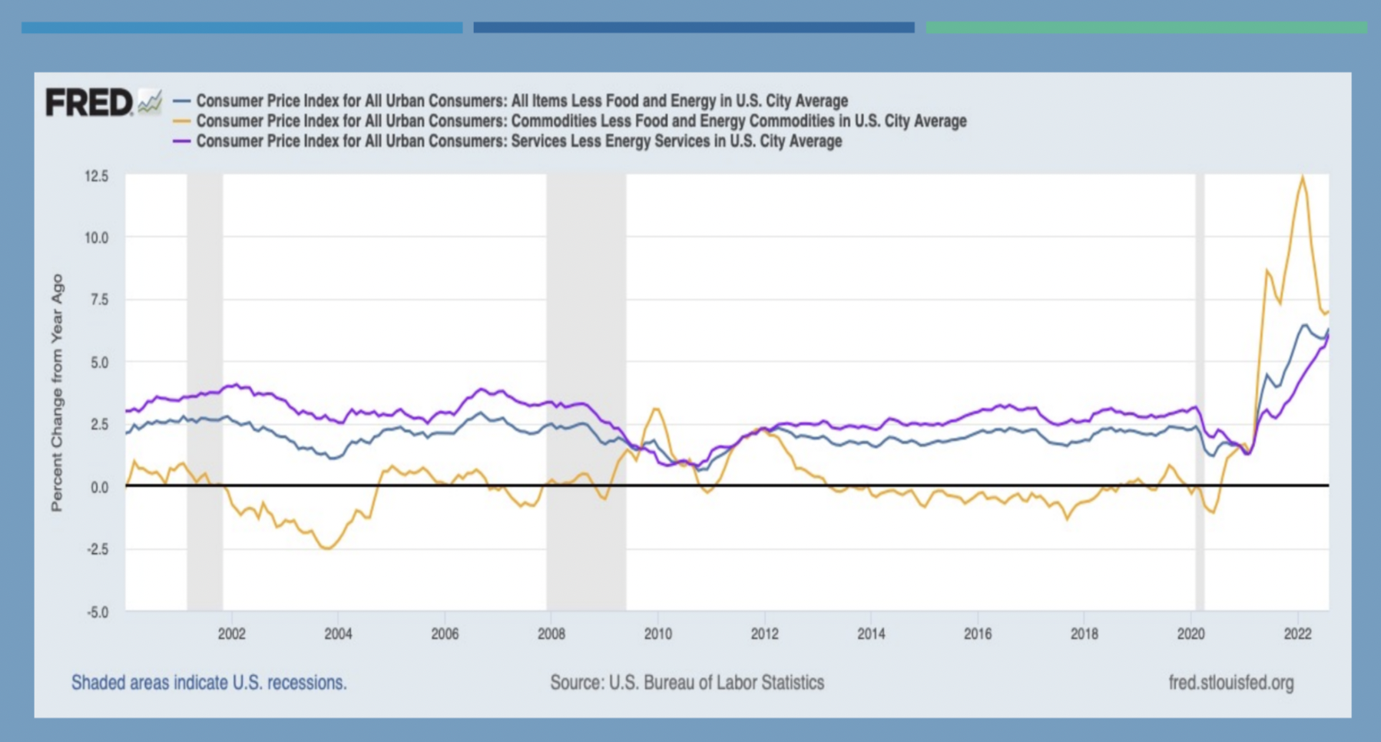
Inflation - CPI-Core has been rising since 2021

Slide 5
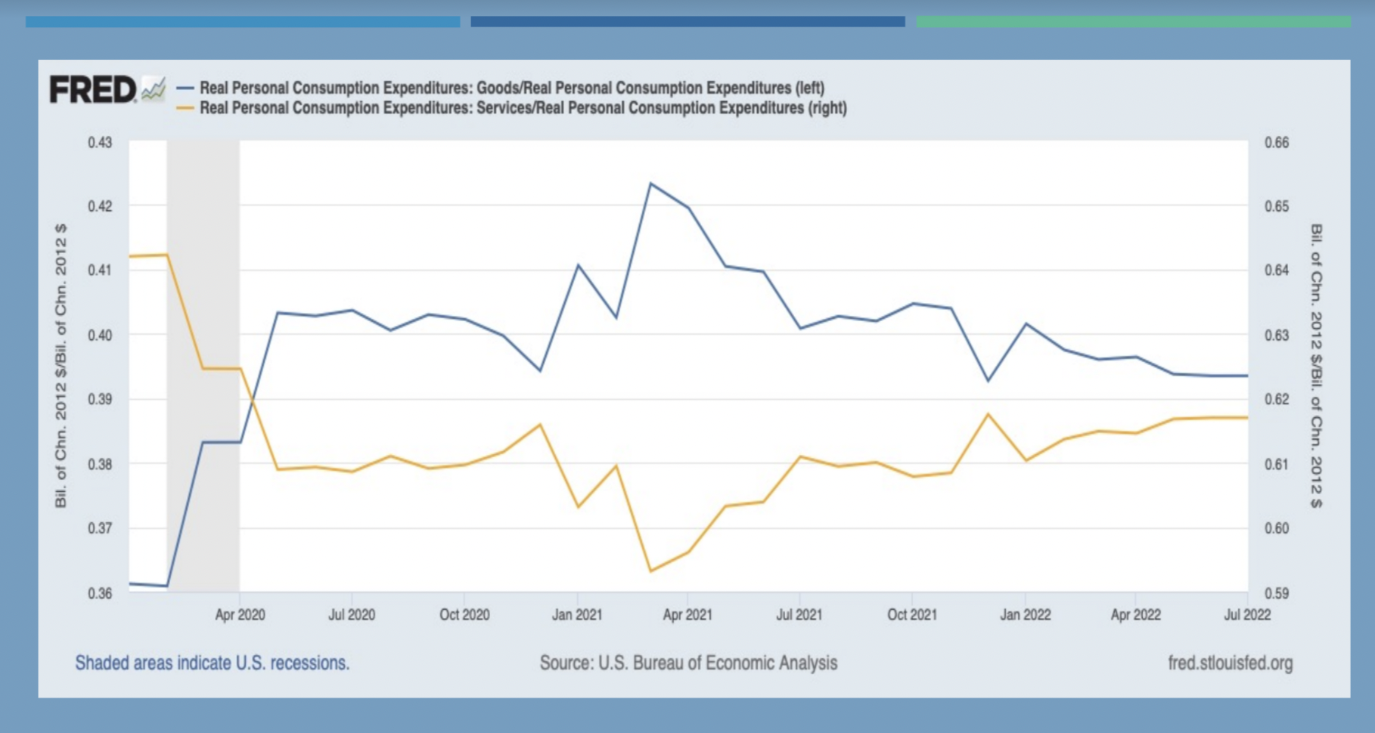
Pandemic - Services vs. Goods Consumption reversed

Slide 6
Inflation discussion
Where have you been seeing the most inflation?
How did you handle the unexpected inflation last year?
Did you build sufficient inflation into your budget this year?
Are you planning to build inflation into your budget for next year? How much?

Slide 7
Supply Chain Issues aren’t going away*
Pandemic immediately shut down manufacturing around the world
Severe freeze in Texas (2/21) - petroleum resin
Hurricane Ida in Louisiana (9/21) - plastics
Ukraine war and subsequent shipping blockades/diversions
Semiconductor shortage - construction trucks and equipment
“There is little sign that the supply chain will consistently improve before 2023—or even 2024, in the case of some computer chips. While the lead time for some items has shortened, deliveries for many materials remain delayed or unpredictable. In fact, the expiration of labor contracts for West Coast longshore workers and rail workers nationwide could result in new disruptions of shipments later this year.”
*Information from AGC “Construction Inflation Alert July 2022”

Slide 8
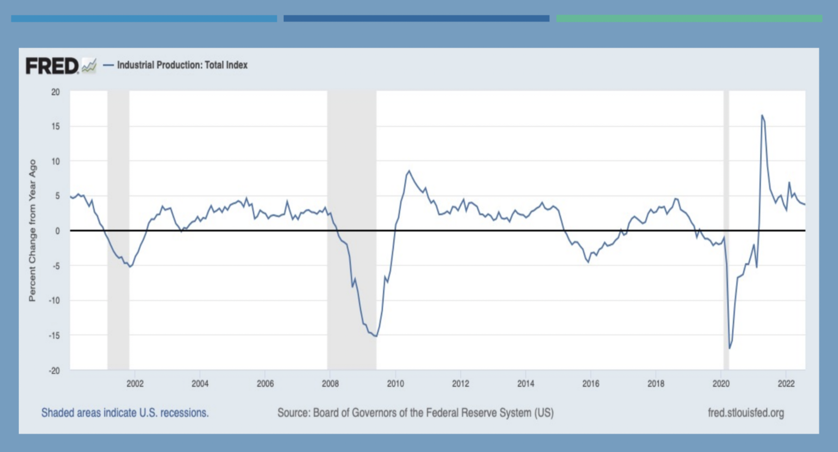
Supply chain issues - uncertain with Ukraine war

Slide 10
Supply chain issues discussion
Which goods have you found to have long lead times
Classroom HVAC equipment - 24-28 weeks (Virginia)
What are good work-arounds when you encounter or know of supply chain issues?

Slide 11
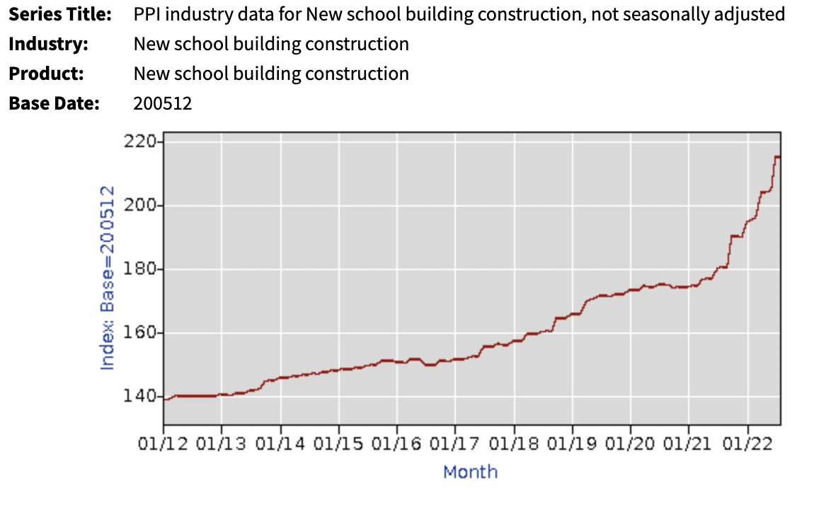
Construction Costs have escalated rapidly in the last year
Bureau of Labor Statistics (latest info 8/2022):

Slide 12
What can we do to mitigate construction cost problems?
Advice from American General Contractors Association “Construction Inflation Alert”, July 2022:
GC needs to let Owner know of issues right away
Owner can authorize price, delay adjustments - more $ but better than GC or subs walking off job
New bids - Owners need to be realistic about current prices, present complete documentation so no potential surprises
Consider a price-adjustment clauses in contract - less contingency, owner can share in downward price adjustments
Order goods earlier - risk storage/theft/damage/insurance issues and/or design adjustment changes

Slide 13
Construction discussion
What type of budget to bid price increases have you seen in your area?
Virginia - 20- 40% (new elementary schools in last four months)
What changes have you made in your bid or contract documents in this ever changing, difficult construction environment?
Any horror stories, words of wisdom?

Slide 14
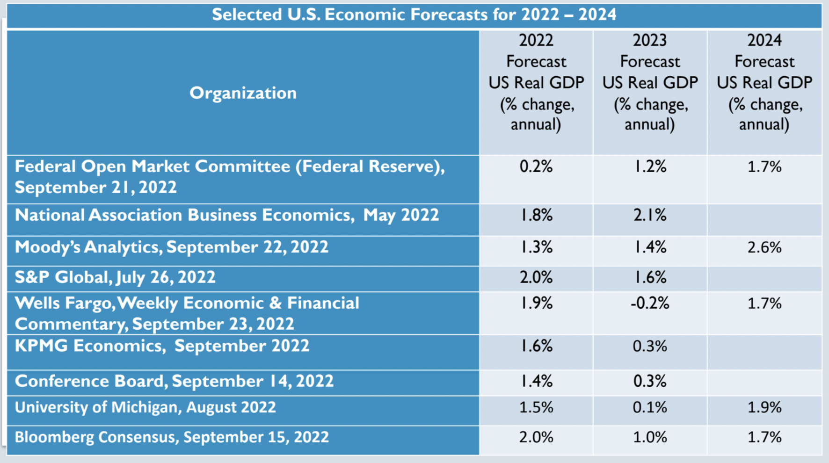
Dr. Bailey presentation to local government finance directors, 9/29/2022

Slide 15
Be ready our next Lunch and Learn session in December!
Please contact Debbie at dwhite@glnd.k12.va.us if you would like original source information for anything presented here.

