Slide 1
Promoting Paperless Processes
CCPS - Automated Leave Slips
Christina Berta, CFO
Paula Aldous, Director of Finance
Chesterfield County Public Schools

Slide 2
Our Agenda for Today
Demonstration as the “Users” would see it
Google Apps that we “Smashed”
The essence of Project Management
The App Smashing - Techie side (6 of the essential formulas & tools)
Hands On with some of the more complicated (but powerful) functions
Questions & Answers

Slide 3
But first …
What is App Smashing?
Launch Demonstrations
My definition of App Smashing is …..
the process of fusing multiple applications with one another to complete a final task or project.
If you were to search “App Smashing” in Google, you would find plenty of examples where folks have grabbed multiple application from all over the web or even desktop to perform all types of tasks. That being said, Google Suite has a whole host of products that when smashed together can enable a plethora of functionality.
Notes:
The slide is the speaker notes. Hyperlink to a video (40sec)

Slide 4
Demonstrations: Point of View from Various Stakeholder groups
END USER
MANAGER/SUPERVISOR
CENTRAL OFFICE
Notes:
https://www.google.com/imgres?imgurl=http%3A%2F%2Fwww.irbsearchblog.com%2Fwp-content%2Fuploads%2F2016%2F03%2Fblog-peopleatwork-1.jpg&imgrefurl=http%3A%2F%2Fwww.irbsearchblog.com%2Fpeople-at-work%2F&docid=WRS686wV-iK00M&tbnid=CMv4Q6TgJM5xpM%3A&vet=10ahUKEwii_KGhxKzhAhWPTt8KHffuBTkQMwiVASgiMCI..i&w=1000&h=297&safe=active&bih=638&biw=1341&q=people%20at%20work&ved=0ahUKEwii_KGhxKzhAhWPTt8KHffuBTkQMwiVASgiMCI&iact=mrc&uact=8
https://www.google.com/imgres?imgurl=http%3A%2F%2Fwww.caddmanager.com%2FCMB%2Fwp-content%2Fuploads%2F2010%2F08%2Fone2many.jpg&imgrefurl=http%3A%2F%2Fwww.caddmanager.com%2FCMB%2F2010%2F08%2Fthe-cad-manager-at-work%2F&docid=XEp05Pvjz8kdhM&tbnid=NtQZhyWSnH6XvM%3A&vet=1&w=412&h=267&source=sh%2Fx%2Fim
https://www.google.com/imgres?imgurl=https%3A%2F%2F3.bp.blogspot.com%2F-_Ess2SBZBPE%2FV5c4BH2XSDI%2FAAAAAAAAAL8%2FUuZfJhN6rMoJ6A12h85mnad3F6fZhiIzwCLcB%2Fs1600%2FJob%252BDescription%252Bfor%252BTime%252BKeeper%252Bin%252BGarments%252BFactory.jpg&imgrefurl=http%3A%2F%2Fcompliancesolutiondesk.blogspot.com%2F2016%2F07%2Fjob-description-for-time-keeper-in.html&docid=mc04aYJO-i7YxM&tbnid=nyYbYFgs6JU1_M%3A&vet=1&w=600&h=501&source=sh%2Fx%2Fim
https://www.google.com/imgres?imgurl=https%3A%2F%2Fwww.bls.gov%2Fooh%2Fimages%2F15607.jpg&imgrefurl=https%3A%2F%2Fwww.bls.gov%2Fooh%2Fmanagement%2Ftop-executives.htm&docid=D63y8mHZsMEtRM&tbnid=YUi5-iPiVUGvEM%3A&vet=1&w=339&h=240&source=sh%2Fx%2Fim

Slide 5
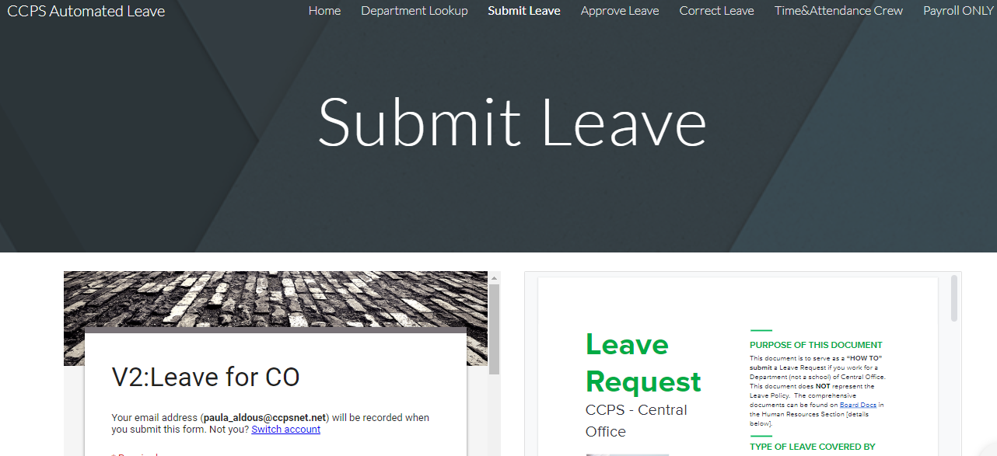
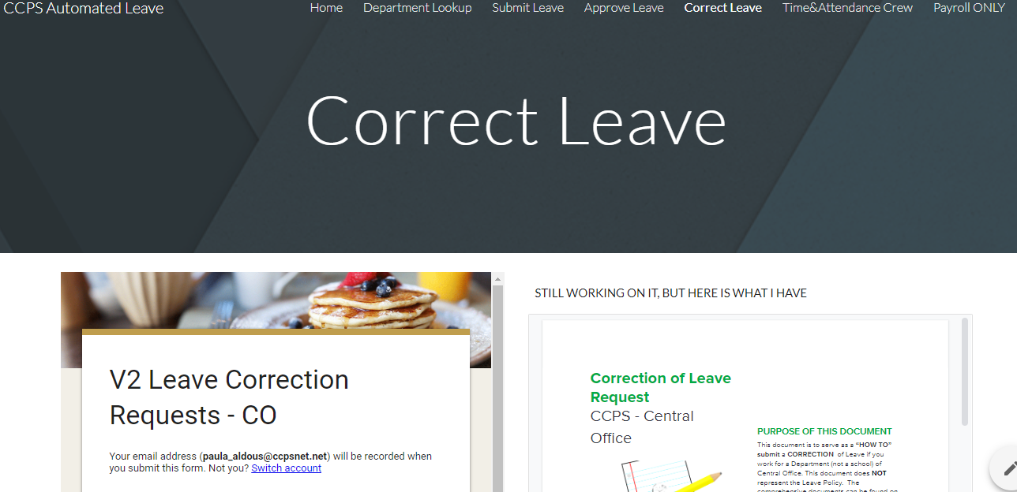
The End User: All employees who need to submit a leave request
Submitting A Leave Request
Correcting A Leave Request
Notes:
All videos are available through Google, however, should the internet not be robust enough to support, all videos are locally stored on Paula’s laptop (C:\Users\paula_schuler\Documents\Camtasia Studio\SASBO)
Submit Leave: POV of the end user on how to submit a leave request (play video) - 4min 10sec
Correct Leave: POV of the end user on how to correct a leave request (play video) - 3min 14sec

Slide 6
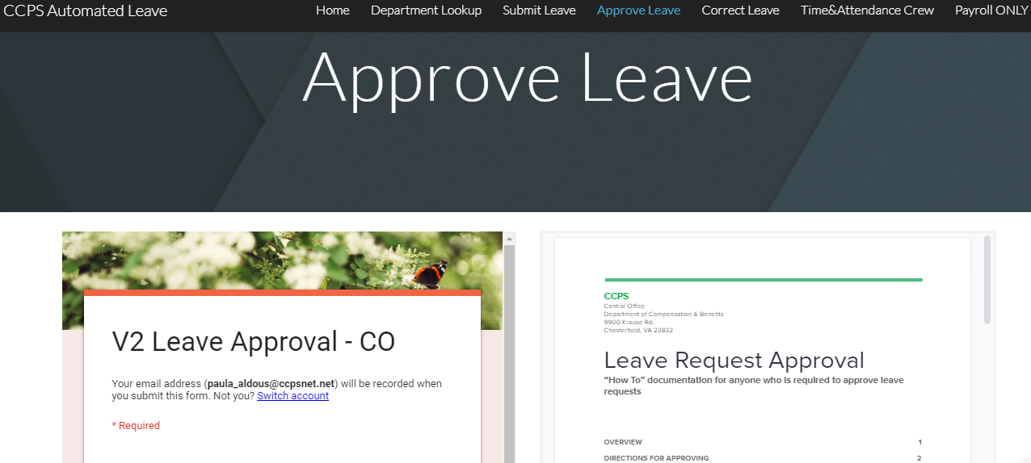
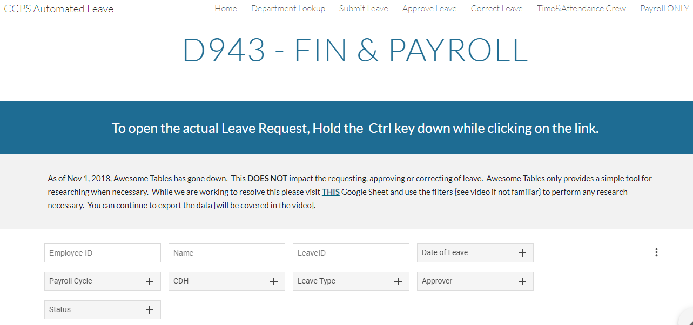
The Manager/Supervisor: All individuals who approve leave requests
Approving / Rejecting a Leave Request
The Managerial Tool - Research / Analysis / Task List
Notes:
Approving Leave: The POV of the Supervisor when a leave request comes in (play video) - 2min 32sec
The managerial Tool: The POV of the Supervisor demonstrating the research tool or how to download data for analysis (play video) 3min 26sec

Slide 7
The Timekeeper: All individuals who have a roll in processing time and attendance
Follow Up Tool(s)
The Reporting / Upload Tool
ONE TOOL, MANY USES
Notes:
Follow Up - When timekeepers need to give the Supervisors a little “tickler” on leave requests that they have not yet reviewed (play video) 56sec
The Reporting/Upload tool - downloading the data for the purpose of reporting and uploading into the System of “truth” (play video) 1min 42sec

Slide 8
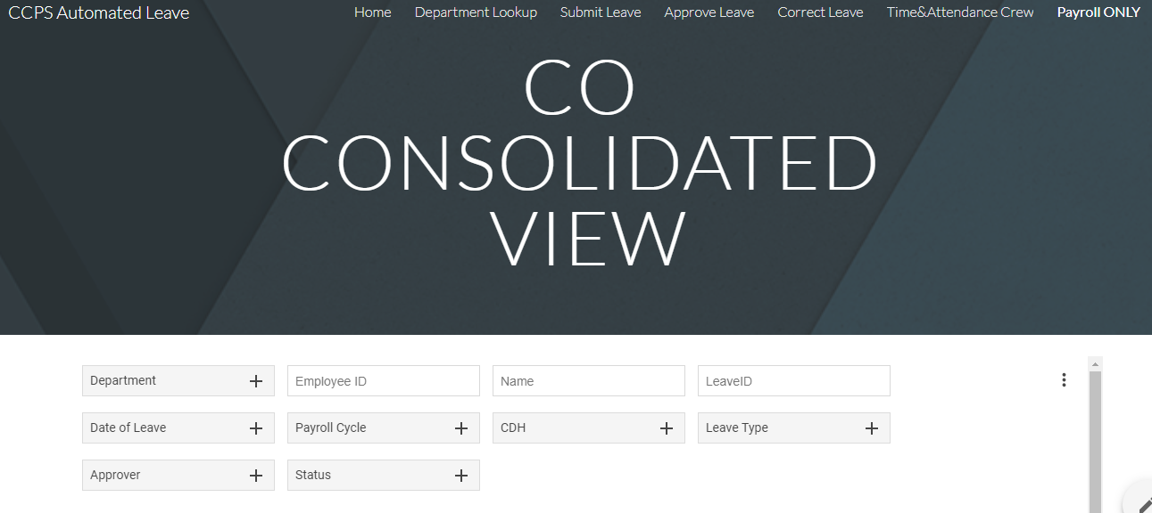
Central Office: All individuals who would benefit from access to macro level data
Payroll Department
Executive Decision Makers
Notes:
Payroll Department - Example would be if you wanted to Central Upload (no video, too similar to what timekeeper does, just larger scale) .
Executive Decision Maker - Example export of macro level data (play video) 1min 48sec

Slide 9
Google Apps that we “Smashed”
Google Drive
Google Forms
Google Sheets
Google Add-Ons (Autocrat)
Google Docs
Google Sites
Notes:
As mentioned previously, Google Suite has a whole host of products that when smashed together can enable a plethora of functionality. I’m going to highlight the major “players” in this system.

Slide 10
Google Apps that we “Smashed”
Google Drive
Notes:
The Google Drive is a service that allows storage and access of files online from anywhere using the cloud. And while this isn’t traditionally thought of as an “application”, the architecture of drive is what enables this “system” work.
Anytime, Anywhere Access! In this case, any part of this “system” can be accessed through any device that has access to the internet.

Slide 11
Google Apps that we “Smashed”
Google Forms
Notes:
A tool that is ideal for collecting web input, creating surveys, tests, or anything else one can dream up. This application facilitates collection of information in a spreadsheet where you can track and evaluate responses - and all of this information is available real time.

Slide 12
Google Apps that we “Smashed”
Google Sheets
Notes:
A web-based spreadsheet tool that allows you to store, organize and analyze different types of information. You can share this data live on-line and as with all Google products, you can restrict share settings from complete openness to view only access. This comes in handy when wanting to give live access to data while preventing any modifications.

Slide 13
Google Apps that we “Smashed”
Google Add-Ons
Notes:
AutoCrat is a multi-purpose document merge tool that allows you to take data from a spreadsheet and merge it into a document via a template. Tell autoCrat which fields to merge via <<merge tags>> and then let autoCrat mass-generate personalized documents. Optionally send the documents as email attachments. In our example today, autoCrat will run the meger when new forms are submitted to created truly automated processes.
https://chrome.google.com/webstore/detail/autocrat/ppgnklghfnlijoafjjkpoakpjjpdkgdj?hl=en-US

Slide 14
Google Apps that we “Smashed”
Google Docs
Notes:
A word processing tool that allows users to collaborate in real-time by creating and editing documents online.
In this case, Google Docs were used for the creation / delivery of the “User Manuals” of this Leave System

Slide 15
Google Apps that we “Smashed”
Google Sites
Notes:
Google Sites is a structured Web page-creation tool offered by Google.
In this case, we leveraged this tool to create a centralized location to disseminate information.
https://encrypted-tbn0.gstatic.com/images?q=tbn:ANd9GcR79jqqTskYV2vpVwjASbdyBqxmC3oLdPMzf8F23_yA4oC5cHQTlA

Slide 16
The essence of Project Management
Planning
Requirements Analysis
Design
Functionality Testing
Acceptance Testing
Notes:
While I did not follow the Agile Project Development model to a “T”, I incorporated the adaptive approach where the detailed planning is minimal and future tasks are driven in respect of what features need to be developed.
Customer Interaction and open communication was the backbone of this project. I utilized the Google Site to create a forum of transparency and promote collaboration. An entire session could be dedicated to project management, but instead, I’m going to take you on a quick journey using the Site I created to assist me.
AT THIS JUNCTURE, I WILL TAKE THEM ON A TOUR OF THE WEBSITE
Home Page
Purpose
The Pages & Stakeholder Groups
The Phases of the project
The impact on current processes
A reflection
The Department Page (demonstrate, live, Awesome table)
Submit Leave
Approve Leave
Correct Leave

Slide 17
Demonstration with some of the more technical features
Array Formula & Concatenation
Vertical Lookups
Conditional Formatting
Queries
Exports
Creation of merge and email script
Notes:
I am going to pull up a dummy set of data and show how each of these powerful “formulas” were essential to the creation of this system
Array Formula & Concatenation - Created the unique identifier of each leave submission
Vertical Lookups - assigned departments, supervisors & admins based on ID (streamlined input for end user and prevented manual errors)
Conditional Formatting - identified errors easily
Queries - the ability to create unique views of a larger data set for the purpose of controlled distribution
Exports/Import - enable the controlled distribution of data with a refined data set
Creation of merge and email script - merged record level data in a user friendly format combined with the automated routing

Slide 18
Hands on with same technical features
Array Formula & Concatenation
Vertical Lookups
Conditional Formatting
Queries
Exports
Creation of merge and email script
Notes:
I will distribute a dummy data set to all interested and I will walk through the creation of each of these features. We may not have time to get to the merge and email (Autocrat)

Slide 19
Question & Answers
Notes:
If there is time, a bonus will be a demonstration of Awesome Tables.

