Slide 1
Office 365 for Business
Lisa Higgins

Slide 2
My Background
Studied at the University of Dayton, Dayton, OH, Silver Lake college, Manitowoc, WI, and Christian Brothers University, Memphis TN.
Teaching, leading and working with technology since 1987 in Ohio, Utah, Michigan, Virginia and Wisconsin and finally Tennessee.
Director of Technology for Collierville Schools, our District was established in 2012.
We complete our digital initiative in the 19-20 school year.
K-2 students will share iPads – 1 iPad for every 2 students
3-8 students 1:1 with iPads (5-8 take them home)
9-12 students 1:1 with MacBook Airs (all student take them home)
K-5 students have limited O365 licensing
6-12 students have less restricted O365 licensing

Slide 3
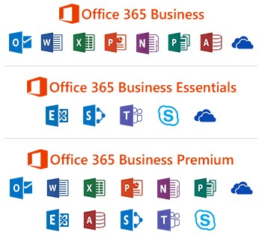
Why use Office 365?
Keeping Tech Current
Dealing with mobile workforce.
Protect company data due to cyber security threats.
Get more done.
Work better together.
Notes:
Keeping tech current.
(Working with Office 365 you have a large array of apps that stay up to date due to cloud based updates.)
Dealing with mobile workforce.
(Nowadays more and more business users are extending the workforce beyond a desk. Office 365 apps help keep a connection between mobile workers with in office workers with the use of apps in the cloud.)
Protect company data due to cyber security threats.
(Company data is protected by the use of settings inside Office 365 apps to limit sharing with certain users and govern certain types of data.)
Get more done.
Enterprise email helps get work done on the go.
(With access to Outlook online you can check messages, flag important emails and do various task as if you were sitting at your desk.)
Access to all your files with online file storage with OneDrive for Business.
(Having ease of mind and confidence that your data is safe and at your fingers tips in Microsoft cloud.)
Work efficiently with integration to other apps and solutions.
Work better together.
Bring together teams and resources all in one place.
(Using Microsoft Teams you can bring together your entire workforce by using one app to centralize Microsoft's most used applications.)
Work anywhere from any device.
(Office 365 cloud-based services can be used on any device, from Windows to MacOS to Linux. Also, with a rich mobile platform Office 365 can easily be accessed on the go.)

Slide 4
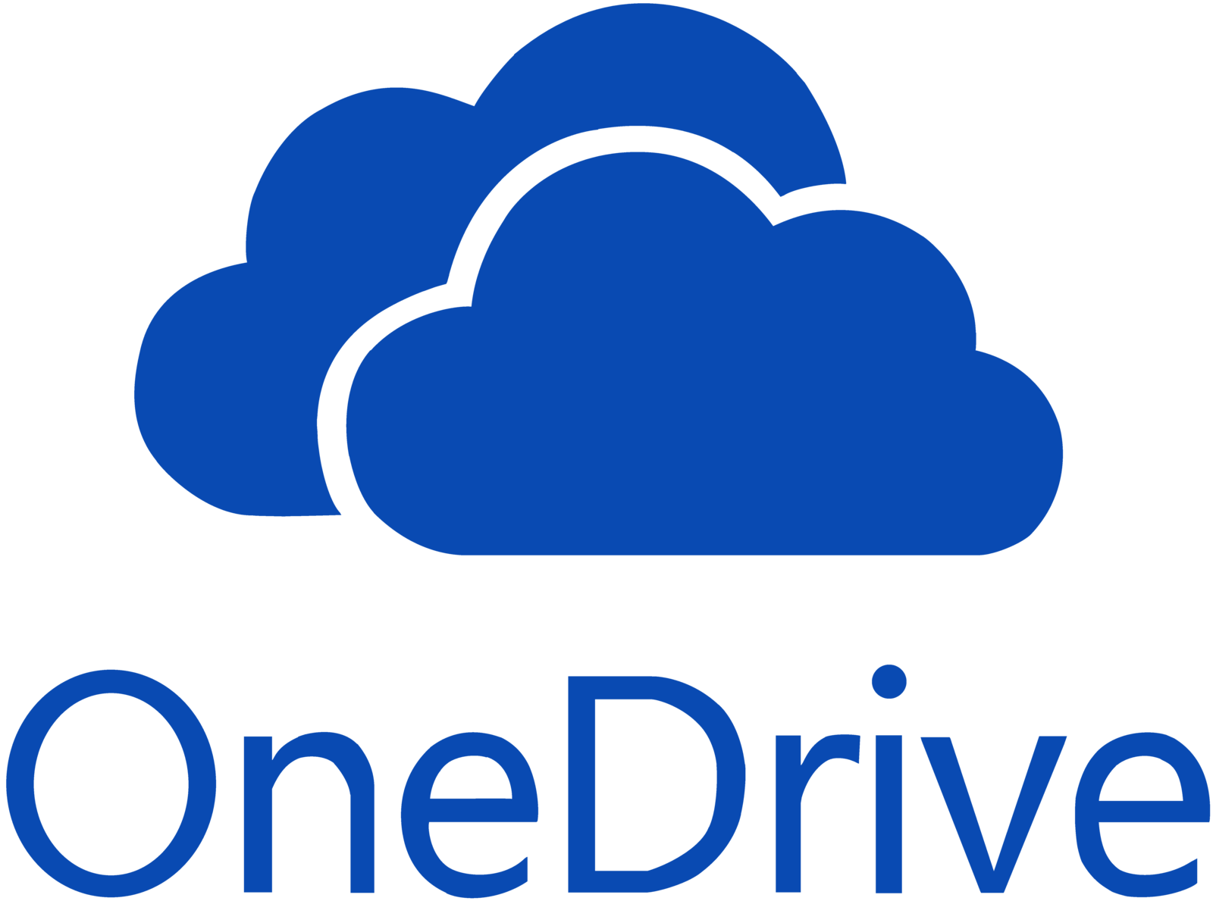
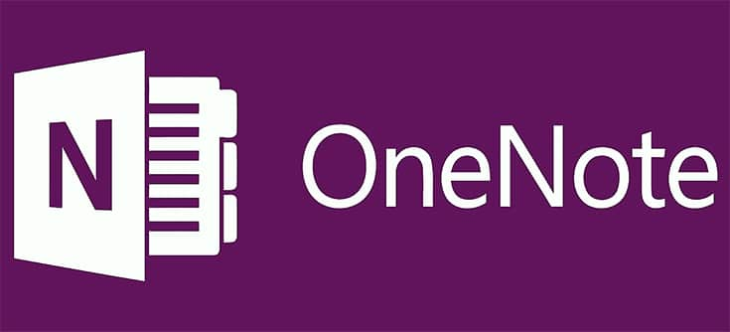
Save - Collaborate – Work
Share with partners outside your organization.
Collaborate on documents at the same time with coworkers.
Sync with Mac or PC to access your file offline.
Version History
Digital Notebook
Share with partners outside your organization.
Collaborate on documents at the same time with coworkers.
Sync with Mac or PC to access your file offline.
Version History
This Photo by Unknown Author is licensed under CC BY-NC-ND
Notes:
Word-Excel-Powerpoint-Outlook-OneNote-OneDrive-Sharepoint-Teams-Forms-Flow
(I won't be going over the basic apps like word, excel, PowerPoint and outlook. I'm going to stick with the apps I feel can help with productivity, collaboration and move creativity forward.)
OneDrive
Save - Collaborate - Work
Share with partners outside your organization.
Collaborate on documents at the same time with coworkers.
Sync with Mac or PC to access your file offline.
Version History
(With 1TB of default storage space OneDrive is ideal for saving files in the cloud and working from any device while at the same time being able to share those files with a person inside or outside or organization. By doing this you are able to collaborate in real time with people to get work done quickly.
Sharing a document with a person inside your organization can give that person access to work on the document in real time with you. Syncing your OneDrive with you PC or Mac gives you access even without an internet connection so you can keep working even in areas with no access. When you are back online your drive will sync to your cloud account. Version history works by letting you see the different saved versions of a document that you have worked on with others or just yourself. This is a powerful tool that can show what updates have been made to a document or just to go back and review older versions. OneDrive is a major player in moving to a cloud based platform for your business. By doing so you will be able to work more closely with business partners and save on time and storage.)
OneNote
Digital Notebook - Save and Organize your notes
(Very quickly we can go over OneNote, it is a powerful tool to take your notes to the next level. In One Note you can have handwritten or typed notes, documents, or even receipts all uploaded to your Office 365 account so they can be safely stored in the cloud and can be easily accessed from anywhere. Sections and Pages keeps your noted organized and everything is searchable. Collaborating on a living OneNote with people inside or outside or organization while in a meeting can ensure everyone stays on task and knowledgeable. Decluttering your workspace by digitizing with OneNote.)

Slide 5
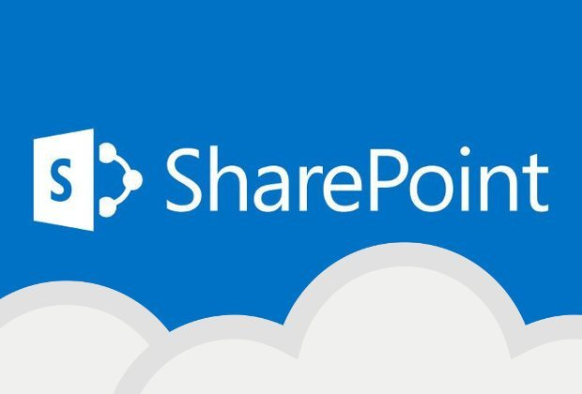
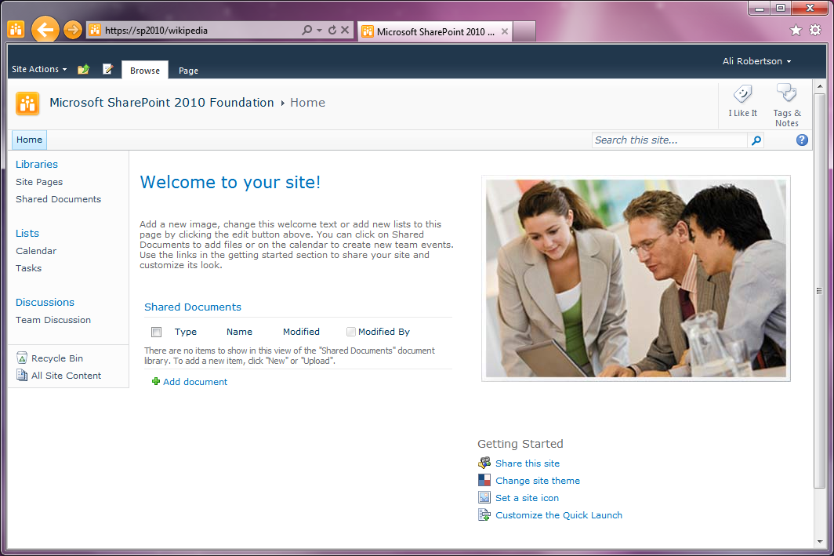
Content Management
Intranet Social Networking
Internal Websites and portals
Collaboration
Notes:
SharePoint
Content Management
Intranet Social Networking
Internal Websites and portals
Collaboration
(SharePoint wears a lot of different hats in the Office 365 environment. Being one of the older apps in use, SharePoint has gone through more than a few changes over the years. If you were to ask a number of people who use the app what it is then you may receive an array of different answers. On the surface, it is a custom online platform used to allow business solutions. Inside the application for one user it is used as an Enterprise Content management platform to have a centralized location of documents and a robust search feature inside of the app. Social Networking can help look up employees or a company directory to find employees with certain skillsets. As far as collaboration that user may use it to work on a proposal and use the tools inside of SharePoint to help out. Internal websites are used for ease of access and can have subsites. The easy use of a website to access your corporations documents and files is essential to working on the move and quickly. Subsites are smaller sites inside a larger company site so workers in a department can work together. Also custom applications or business applications can be created and used to take SharePoint even further and make better business decisions inside your company. SharePoint is used for any or all features that can benefit a business, the accessibly via a webpage helps any level user work together.)

Slide 6
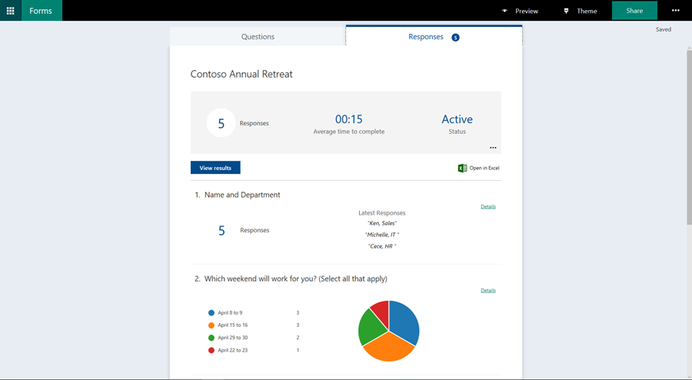
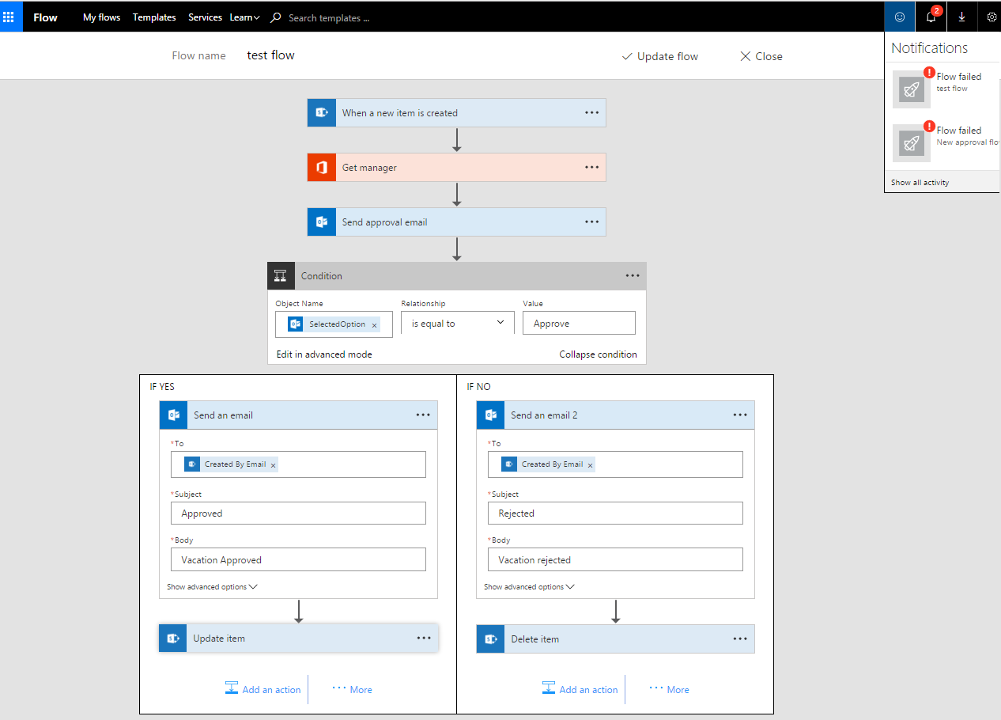
Create - Survey - Collect
Work smarter by automation
Notes:
Forms
Create - Survey - Collect
(Forms can be used in a number of ways, from polling business employees on a company outing to having a teacher give a quiz to a classroom that can be graded and recorded all from the application. On the business side forms are used for customer feedback, employee satisfaction, improve productivity, or organize events. On an educational platform; quizzes, parent/teacher feedback or class activities can be polled and recorded. Collecting info is the main focus of Forms. By using this app in this way employment applications, class signup and suggestion type forms can be utilized and recorded in real time. Surveys can be used to receive feedback and approve processes. These responses can be anonymous this can help with receiving more accurate data. Connecting forms to Excel online you can have your data saved to your OneDrive to have access to it anywhere and also share a Form with someone to help with creation. Forms has a variety of question types and can be simple to complex by linking questions based on answers to randomizing questions and answers. Using Forms with other applications within the Office 365 environment can make for an immersive tool that can leverage productivity and customer satisfaction.)
Flow
Work smarter by automation
What makes a flow?
Connectors
Templates
(This app takes away your daily or weekly task that you may be doing manually to start a process and send an email to a user or something else entirely. A Flow helps non-developers work smarter by automating tasks and work flows across services. So what makes a flow? You have three parts to a flow. 1. The Trigger, this is the action that starts the flow it can be started by a Data event like an excel file being update or a form being filed out. Manually Triggered by a physical button is pressed or on mobile button, or started by a scheduled flow. 2. Actions, when something happens then an action will take place. An action can email a user or even save to OneDrive or something else. The possibilities for a trigger or action are huge! Microsoft has over 215 connectors to choose from to connect products and actions. These are just out of box connectors. You can also work with APIs to create your own connectors with different products that are not in the Microsoft system. Flow templates are to be used as a starting point or is you want something simple you can just use a premade template. For more complex situations you may start with a template and customize this for larger more complex actions. As with all the other products you can collaborate with others on making the process….Flow.

Slide 7
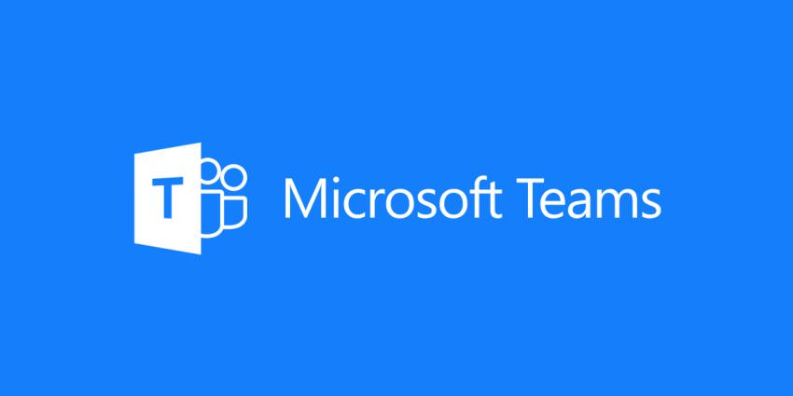
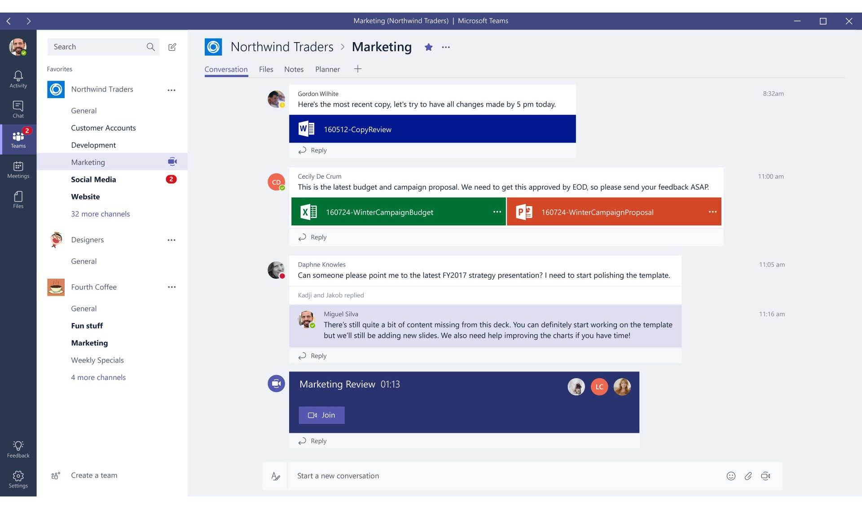
Work better together
Notes:
Teams
Work better together
Bring together teams and resources all in one place.
Work anywhere from any device.
Host online meetings inside of Teams.
Central hub for collaboration
(The central focus for Office 365 for Business seems to be collaboration. Teams brings everything together. At its core it is the Skype for Business replacement and a chat tool, but on the outside it is almost every 365 app rolled into one. With the creation of an Office 365 group you are also creating a host of other things behind the scenes from a email account to a SharePoint site and even a Teams channel. All of these things are created. This is because Microsoft wants you to have a less steps of creation and more collaboration. Once in Teams you have the option to add users to your Team and create channels. These channels can be specific to certain groups or products used by your organization. By creating channels focus can be on that one area and not on the whole organization. Files are stored in a centralized location via OneDrive and can be accessed by anyone in that Team. You can chat with the entire group or individually for one on one collaboration. By adding apps to Teams you can make the flow of work richer. OneNote can be added to insert notes. Forms can be added to poll the team and a whole host of other apps. From bots to PowerBI. You can set meetings quickly inside of Teams to call a quick meeting to share a whiteboard and go over a task. As I said Teams at its core is a chat tool and this chat is more robust that Skype with HTML formatting and easy GIF selection for friendly banter with coworkers. Teams is the central hub for Office 365 and its initiative for collaboration with partners and employees.)
(With these products inside your organization you will be better able to work together with coworkers and partners inside and outside of your location. Microsoft has been will invested in making these tools work seamlessly with each other and still works on updating them via cloud based updates. You may turn on Teams one day and see a brand new feature or a new question set in Forms. With Microsoft still pushing for better collaboration these products can be a hub for your organization.

