Slide 1
Pennsylvania Association of School Business Officials
FRAUD IN A FALTERING ECONOMY: REVISITED
Presented by:
David L. Nester, PRSBA Business Administrator
Pottsgrove School District
Christopher M. Turtell, Audit Manager
Herbein + Company, Inc. CPA’s

Slide 2

What is Fraud
Webster’s Dictionary
Occupational Fraud – use of one’s occupation for personal enrichment through deliberate misuse or misapplication of the employing organization’s resources or assets.

Slide 3
Types of Fraud
Fraudulent Reporting
  A misstatement or omission of amounts or disclosures designed to deceive financial statement users.
Misappropriation of Assets
  The theft of an entity’s assets, such as embezzlement, which causes payment for goods or serves to not be received.

Slide 4
Quote
Good people do not need laws to tell them to act responsibly, while bad people will find a way around the laws.
-Plato

Slide 5
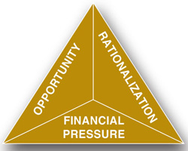
Fraud Triangle

Slide 6
Facts about Fraud
Anyone with rationalization, opportunity, and pressure can commit fraud.
Most frauds are not well concealed, there is usually either a weakness in design or operation of an internal control.
“Trusting an employee” is not a substitute of internal controls.

Slide 7
Facts about Fraud cont’d.
Newspaper writers will not decipher between small and big dollar amounts nor will they decipher between booster clubs and the district they serve.
Recovering from a fraud takes more resources than putting controls in place to help prevent it from occurring.
It can happen anywhere.

Slide 8
Factors Contributing to Fraud
Poor internal controls
Management override of internal controls
Collusion between employees
Collusion between employees and third parties
Outside pressures such as financial hardships or addictions.

Slide 9
Increased Risk Factors in PA Schools
High Unemployment
Declining Property Values
Struggling Real Estate Market
Non-existent Interest Earnings
Low Act 1 Index
Relatively Flat State Support
Rising Healthcare and Retirement Costs

Slide 10
The Result
Districts are forced to do more with less!
  Staff Reductions
  Pay Freezes
  Benefit Reductions
          Discontented Employees
          Impaired Internal Controls
          Opportunity!

Slide 11
What to Expect when Fraud is Identified
Professional Impact:
  Public questioning
  Additional time demand to conduct an investigation
  Public perception
Personal Impact:
  How it affects the perpetrator
  How it affects you

Slide 12
Examples of Fraud in PA
School Districts
Disclaimer: The purpose of the following information is to show that fraud can happen to you. With the exception of Pottsgrove School District, we do not express any opinion of guilt on the part of any of the parties. These issues are traumatic to all involved. Our goal is that you take measures necessary to limit your exposure to fraud.

Slide 13
Support Organizations
“Ex-Penn-Delco Official Arraigned on Theft Rap”
  School Board member served as Treasurer for Booster Club
  Convicted on theft and forgery charges
  Loss of > $21,000 from 2005-2008
  Source: Delco Times 7/19/12

Slide 14
District Credit Cards
“Erie Man Faces Trial for Theft from School District”
  Substitute custodian at Erie School District
  Purchased fuel with stolen credit cards
  Loss of $13,700 in 3 months
  Source: Erie Times 8/9/12
“Former Supervisor Charged with 154 Counts of Fraud”
  Transportation Supervisor at Tredyffrin/Easttown School District
  Purchased fuel for personal use with District credit card
  Loss of > $8,000 in 1 year
  Source: Times Herald 2/21/13

Slide 15
Athletics and Student Activities
“Auditor General’s Special Investigation finds Former AD took more than $60,000”
  Dallas School District Athletic Director
  Diverted 231 checks over 6 years
  Source: PA Auditor General 10/25/10

Slide 16
Food Service Program
“Audit Finds Nearly $100K Stolen from Charleroi School District”
  Two food service workers involved
  Identified by District and audit requested
  Possible gambling problem
  Loss of nearly $94,000 from 2010 – 2012
  Source: WTAE.com 1/31/13
“Former Secretary Charged with Stealing Money”
  Food service secretary at Greater Nanticoke Area School District
  Loss > $19,000
  Source: www.WNEP.com 12/4/12

Slide 17
Retiree Benefits
“Pottsgrove School Embezzler Sent to Jail”
  Benefits Coordinator at Pottsgrove School District
  Altered retiree checks and either cashed or deposited to personal accounts
  6 checks from 2008 - 2010
  Loss > $36,000
  Local credit union notified a retiree that someone was attempting to cash a check that looked odd
  Sentenced to 7-23 months in jail and restitution
  Source: Pottstown Mercury 7/28/2010 / Pottsgrove School District

Slide 18
Unauthorized Accounts Payable Checks
Accounts Payable Specialist at Chichester School District
Electronically altered A/P checks to her name
Loss > $41,000 in 11 months
Found in May, 2006 while preparing for audit
Sentenced to 1 year in County prison plus restitution
Source: Chichester School District

Slide 19
Payroll and Construction Funds
“Baldwin-Whitehall Payroll Clerk Linked to $300K Theft from School District”
  Funds missing from payroll, athletic and construction funds
  Tip received from bank that someone was attempting to cash a duplicate check
  Performed audit to quantify loss
  Period 2002-2009
  Source: Tribune-Review 7/25/09

Slide 20
Transportation Contracts
“Former Lakeland School District Transportation Director Pleads Guilty to Federal Program Fraud”
  Director steered contracts to a transportation contractor that he had a financial interest in
  Period 2006-2009
Source: www.FBI.gov 8/10/11

Slide 21
Intermediate Unit
“Executive Director Charged with Defrauding Northeastern IU #19”
  Alleged that ED directed employees to perform home maintenance at personal residence, personal secretarial, shopping and other services
  False travel vouchers
  Undocumented time off
  Period 1998 – 2010
  Amount material but not quantified
    Source: US Dept of Justice (www.justice.gov) 2/21/12

Slide 22
Federal Programs
“Charter School Director Pleads Guilty to Program Theft”
  Ex Superintendent of Glendale School District
  “intentionally misapplied” $49,600 for Improvement of Education grant (Title 1?)
  Conspired to obtain E-Rate funds - $414,422
    Contracted to connect rural homes to internet – never occurred
  Source: Salt Lake Tribune 5/16/11

Slide 23
Charter School
“Charter School Founder Charged in $6 Million Fraud Scheme”
  Founder of Agora Cyber Charter School and Planet Abacus Charter School charged with causing these schools to make fraudulent payments to her privately owned management companies
  Management contracts were not approved by the Boards of the Charter Schools
  Source: www.FBI.gov 7/24/12

Slide 24
Bensalem School District
“20 Busted for $1.2 Million in Suburban School District Thefts”
  Two ghost employees on grounds crew
    Spouse of one was Grounds Foreman - clocked employees in
    Ghost employees rarely worked
    Loss estimated at $207,000
  Bus Garage Theft Scheme
    Lead mechanic and shop foreman sold vehicle parts purchased with District Funds
    Scrapped 30 vehicles w/o compensation to District - Lead mechanic and other car club members were given free access to parts from the junkyard
    Loss estimated > $1 million
    Period 10 years
Source: Philadelphia Inquirer (www.philly.com) 2/13/13

Slide 25
External Fraud
Municipality notices out of sequence checks clearing their bank account.
  Two individuals stole a municipality check intended for a vendor and created a copy for personal use.
  They wrote the checks out to the homeless individuals who agreed to take the check to the municipalities home bank to cash and receive a percentage of the money.
  The activity was caught the day the check was posted to the bank account by the finance manager at the municipality as she updated her bank reconciliation using her online banking access.
  Authorities were notified and the individuals were apprehended a week later when they returned to the bank to attempt to cash additional checks.

Slide 26
Outside Impact
Computer Viruses
Tax Collector Fraud
Vendor Scams

Slide 27
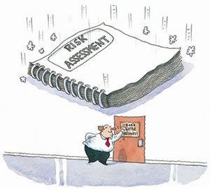
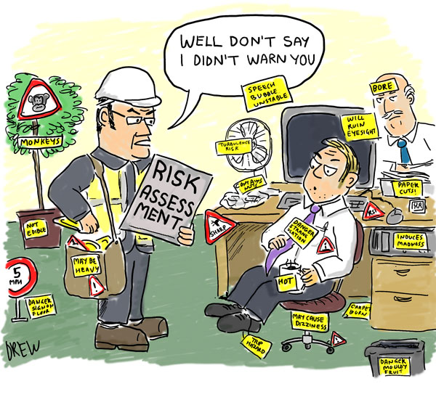
Internal Controls

Slide 28

Internal Controls cont’d.
What are internal controls?
  Anything that you do to safeguard district assets or make more efficient and effective use of those assets
  First line of defense to prevent and detect fraud
  Integral component of an organization’s management , providing reasonable assurance that objectives are being achieved.

Slide 29

Components on Internal Control
Control Environment – Tone at the top
Risk Assessment – Identifying the areas of greatest risk within the entity
Information and Communication – Distribution of financial information and communication of all information throughout the entity

Slide 30
Components of Internal Control cont’d
Control Activities – Policies and procedures established to mitigate risks in varying levels of the business process to the achieving managements directives.
Monitoring – The ongoing evaluations of whether the five components of internal control are present and functioning.

Slide 31

It’s all about control…
The need for controls:
  Reduce fraud opportunities
  Establish standards of performance (tone at the top)
  Assure compliance
  Preserve integrity
Internal controls provide reasonable assurance that a material misstatement will be detected.

Slide 32
And Perception
The perception of detection deters more perpetrators than controls alone.
Communicate internal controls to all employees so they are aware of the controls in place
Those who perceive they will be caught committing fraud are less likely to commit it.

Slide 33
Detection of fraud schemes
Percent of Cases
*”Other” category was not included in the 2010 Report.
Source: The ACFE’s 2012 Report to the Nations on Occupational Fraud and Abuse
ACFE.com/RTTN

Slide 34
Auditors Responsibilities
Auditing Standards require the auditor to gain an understanding of the organization’s internal controls.
Government auditing standards require the auditor to plan the audit to obtain sufficient evidence so that audit risk is will be limited to a low level.

Slide 35
Auditors Responsibilities cont’d
Auditors focus on items that could lead to a material misstatement in the financial statements for an opinion unit.
Notify the client if any unusual items are noted in testing.
Provide suggestions in the way of a management letter for improvements that can be made to strengthen internal controls.

Slide 36

Common Red Flags
Personal finance pressure
Vices such as gambling or substance abuse
Extravagant purchases or lifestyle
Real or imagined grievances against the organization or management
Increased stress
Short vacations or unexplained hours
“Missing” files or data

Slide 37
Ending Thoughts
“The world is full of obvious things which nobody by any chance ever observes.”
― Arthur Conan Doyle
There's nothing like doing something wrong to learn how it might be done better.
  David Knopfler

Slide 38
Questions?

Slide 39
Contact Information
David L. Nester, Business Administrator
Pottsgrove School District
(610) 327-2277 x1004
Dnester@pgsd.org
Christopher M. Turtell, Audit Manager
Herbein & Company, Inc.
(610) 378-1175 ext. 140
Cmturtell@herbein.com

