Slide 1
Final Rule
National School Lunch Program
Healthy Hunger Free Kids Act 2010
New Regulations for School
Lunch and Breakfast Programs

Slide 2

Clare Keating, SNS
Vice President of Marketing
Preferred Meal Systems, Inc.
Berkeley, IL

Slide 3

Changing the Face of School Meals
Important Changes to School Meal Programs
The Healthy Hunger Free Kids Act 2010
Final Rule on Nutrition Standards
  Changes to current regulations
  New Nutrition Requirements, Meal Patterns
  Timeline of Changes
  Costs and Reimbursements
What You Need to Know

Slide 4

School Meals Under Scrutiny
Childhood Obesity
  More than tripled in the last 30 years
  From 7% in 1980 to 20% in 2008
  In 2008 more than 1/3rd Children and Adolescents considered overweight or obese
Nutrition Education no longer
being learned at home

Slide 5

School Meals Under Scrutiny
High Visibility in School Meal Programs
  First Lady’s “Let’s Move” Campaign
  Media attention (Jamie Oliver, etc.)
  Passing of the
  Healthy Hunger Free
  Kids Act 2010

Slide 6

Healthy Hunger-Free Kids Act of 2010
Child Nutrition Reauthorization occurs every 5 years
HHFKA Signed in to Law in December of 2010.
Amends and Updates the National School Lunch Act to improve nutrition in school meal programs

Slide 7
The Goal
Educate children on better eating habits
  Increased access to healthy foods
  Identifying fruits and vegetables
  Increasing fiber and decreasing sodium, fat and calories
Reduce obesity
Improve overall health of the nation
Help schools to accomplish this goal

Slide 8
Final Rule on Nutrition Standards
As part of the HHFKA 2010, the USDA, Food Nutrition Services (FNS) released new meal patterns and nutrition standards, January 2012
Phase in over 3 years beginning July 1, 2012
Additional .06¢ at lunch upon menu approval
  Available October 1, 2012

Slide 9
Final Rule
Published in the Federal Register- Nutrition Standards in the NSLP and SBP (76 FR2494)
Based on 2009 Institute of Medicine report
Revised from Proposed Rule published Jan 2011
  90 Days Public Comment
  Extreme Interest- 133,268 Comments
QA Clarifications on final continue to be released

Slide 10
Summary of Final Rule
One Meal Pattern, 3 Age Groups
Separation of the Fruit/Juice/Veg Category
  Increases in Fruit and Vegetables, each offered Daily
  Vegetable subcategories offered weekly at Lunch
Increase whole grains, fiber
Limit Protein and Grains with ranges, min and max
Milk- two varieties, Fat free or 1%
Limit Calories with ranges, minimum and maximum

Slide 11
New Meal Pattern
One Food Based Menu Planning Approach
  Eliminates Nutrient-Based and Enhanced
3 Age/Grade Groups
  Grades K-5 (age 5-10)
  Grades 6-8 (age 11-13)
  Grades 9-12 (age 14-18)

Slide 12


The Changes
Increase portions of Fruits and Vegetables
Increased cost $
  Additional ½-1¼ cup

Slide 13
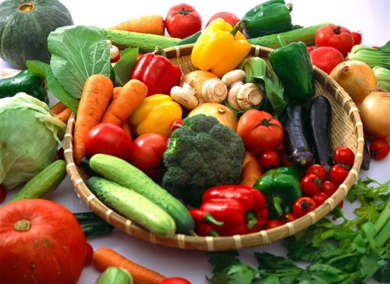
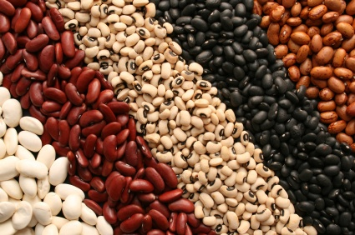
Changing Standards
Vegetable Subgroups required weekly:
  Dark Green Leafy - Starchy
  Red / Orange - Other
  Legumes

Slide 14

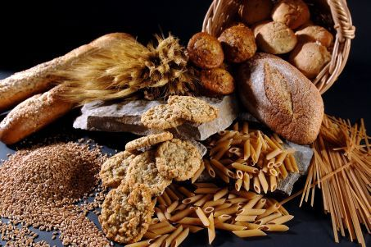


Changing Standards
Whole Grains
Low Sodium
Limits on Calories,
Saturated Fat, Trans Fat
Notes:
Convert all white flour products to whole grain by 2014
Reduce sodium in products by 25-50%
Eliminate Trans Fat
Concentrate on Low Fat, Low Sugar

Slide 15
Changes- Lunch
 | Current Requirement | New Requirement
Fruit and Vegetables | 3/4-1 Cup of Fruit and Veg combined per Day | ¾-1 Cup of Veg per day plus ½-1 cup fruit per day
Vegetables | No specifications as to type | Subcategories with weekly requirements for dark green, red/orange, legumes, other and starchy.
Meat / Meat Alternate | 1.5- 3 oz. daily average over 5 day week | 1 oz. Minimum per day (2 oz 9-12), weekly minimum and maximum
Grains | 1.8-3 oz equiv daily average | Min 1 oz per day (2 oz 9-12), weekly minimum and maximum
Whole Grains | Encouraged | At least half of grains to be whole grain rich *All whole grain rich SY 2014-15
Milk | 1 cup | 1 cup, 2 Varieties offered- Fat-free and/or 1%. Flavored Milk must be fat-free

Slide 16

New Regulations- Lunch
Fruits
Fruits and Vegetables now offered as separate components
K-8-½ cup per day, HS- 1 cup
No more than half weekly
requirement can be met
with juice

Slide 17
New Regulations- Lunch
Vegetables
K-8- 3/4 cup Daily, 9-12- 1 cup
Vegetable Subgroups
  Dark Green- ½ c. per week
  Red/Orange- ¾ c. per week (HS 1¼ c.)
  Legumes- ½ c. per week
  Starchy- ½ c. per week
  Other- ½ c. per week
    (HS ¾ c.)

Slide 18

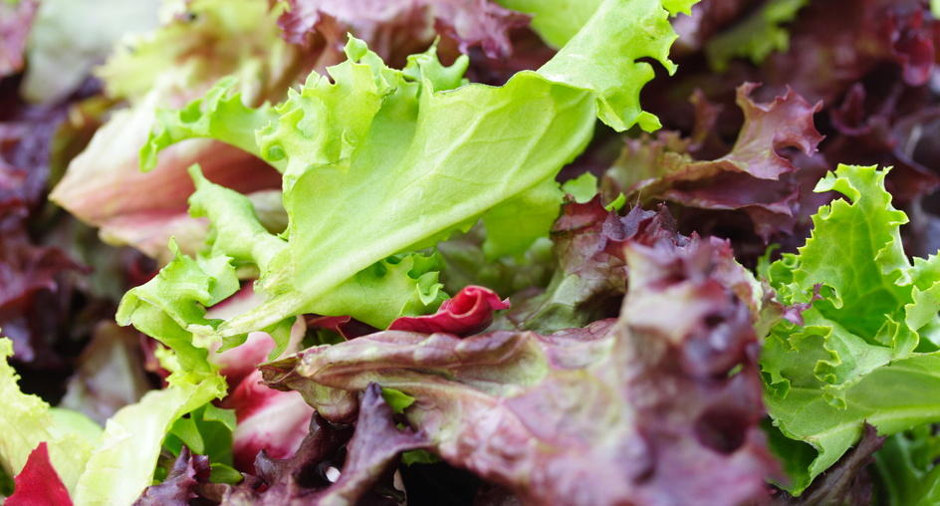
New Regulations- Lunch
Fruits and Vegetables
Credited by Volume as Served Except:
  Dried Whole Fruit = twice volume served
  Leafy Salad Greens= Half volume served (double portion)
  Pastes and Concentrates can be counted as whole equivalent. E.g.- tomato paste=tomato

Slide 19
New Regulations- Lunch
Grains
Minimum and Maximums
  K-5= 8-9 sv, 6-8= 8-10 sv, 9-12= 10-12 sv
Half whole grains 2012-13
All whole grains 2014-15
Grain / Fruit combinations
are not allowed
1 oz. = 1 serving

Slide 20
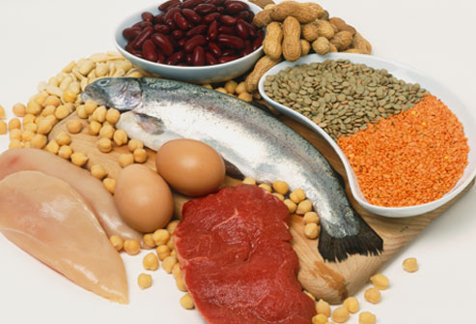

New Regulations- Lunch
Meats / Meat Alternates
Minimums and Maximums
  K-8 Min. 1 oz daily, K-5=8-10, 6-8=9-10 /week
  9-12 Minimum 2 oz daily, 10-12 /week
Single choice menus
can’t repeat type or form
more than 3 times per week
Lean Meats encouraged-
processed meats
discouraged

Slide 21
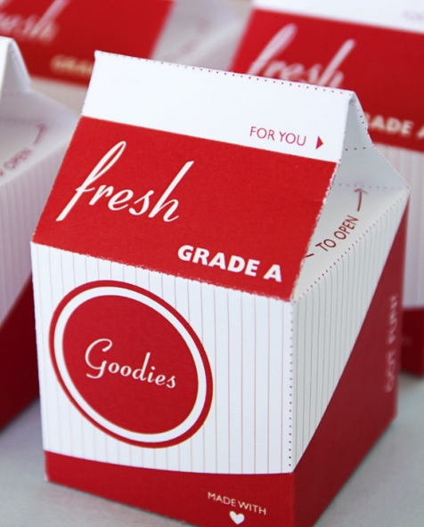
New Regulations-
Milk
May only offer 1% Fat or Less
Flavored Milk must be Fat Free
Must offer two varieties
  FF Flavored, FF White
  FF Flavored, 1% White
  FF White, 1% White

Slide 22
Offer vs. Serve- Lunch
5 Components Offered
Students must take at least 3 components
Of the 3, students must select ½ cup of either a fruit or vegetable serving or a ½ cup combination of both

Slide 23
Changes- Breakfast
 | Current Requirement | New Requirement
Fruit | ½ Cup per Day | 1 Cup per Day (2014-15)
Grains and Meat / Meat Alternate | 2 Grain or 2 MMA or 1 of each | 2 Grains per Day, may sub 1 oz meat
Whole Grains | Encouraged | At least half of grains to be whole grain rich (2013-14) *All whole grain rich (2014-15)
Milk | 1 cup | 1 Cup, 2 Varieties offered- Fat-free and/or 1%. Flavored Milk must be fat-free

Slide 24
New Regulations- Breakfast
Fruits
Fruits and Vegetables now offered as separate components
1 cup Fruit per day (2014-15)
No more than half requirement can be met with juice
May sub fruit with a
vegetable but first 2 c. must
be from DG, R/O or Legumes

Slide 25
New Regulations- Breakfast
Grains
Minimum and Maximums
  K-5= 7-9sv, 6-8= 8-10sv, 9-12= 9-10sv
Half whole grains 2013-14
All whole grains 2014-15
May sub 1oz with 1oz MMA
Grain / Fruit combinations
not allowed
1 oz. = 1 serving

Slide 26
New Regulations-
Milk
May only offer 1% Fat or Less
Flavored Milk must be Fat Free
Must offer two varieties
  FF Flavored, FF White
  FF Flavored, 1% White
  FF White, 1% White

Slide 27
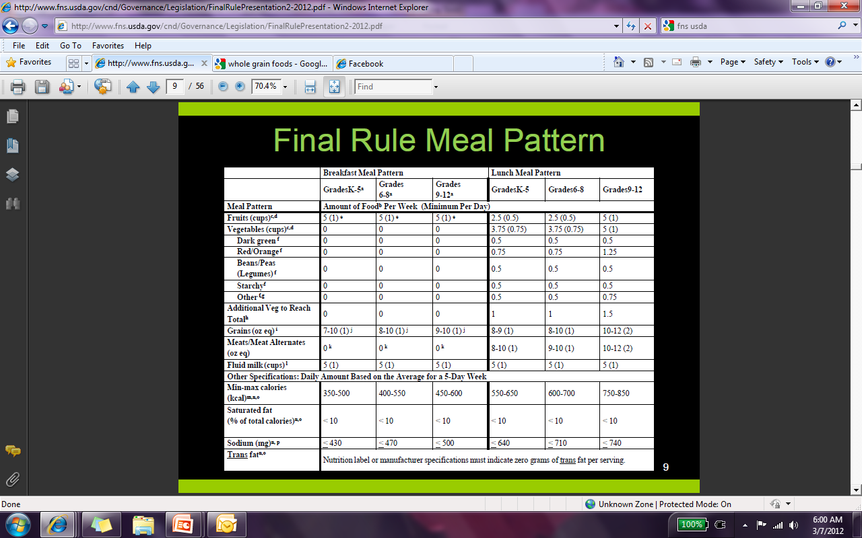
New Nutrients Standards
Focuses Only on Nutrients in 3 key Areas :
  Calories (incorporates “ranges”)
  Sodium (< 1500 mg per day)
  Saturated Fat (< 10% of total Calories)- no change
Zero g. Trans Fat

Slide 28
Calorie Ranges
* Menus may be combined to meet overlapping targets
Breakfast
  Grades K-5 350-500
  Grades 6-8 400-550
  Grades 9-12 450-600
  K-8 Overlap= 400-500, 1 c. Fruit, 8-10 Grains
  K-12 Overlap=450-500, 1 c. Fruit, 9-10 Grains
Lunch
  Grades K-5 550-650
  Grades 6-8 600-700
  Grades 9-12 750-850
  K-8 Overlap= 600-650, 8-9 Grains, 9-10 MMA
  No 9-12 Overlap

Slide 29
Sodium Reductions
Targets are to be reached by 2022
  Maximum limits on sodium Gradual implementation
  Target 1: SY 2014-2015
  Target 2: SY 2017-2018*
  Final Target: SY 2022-2023*
  * Prior to implementation of Target 2 and the Final sodium targets, USDA will evaluate relevant data on sodium intake and human health

Slide 30
Implementation Timeline
Depicts when each requirement will be phased in for both breakfast and lunch over next 10 years
Letter “L” denotes lunch and letter “B” denotes breakfast

Slide 31
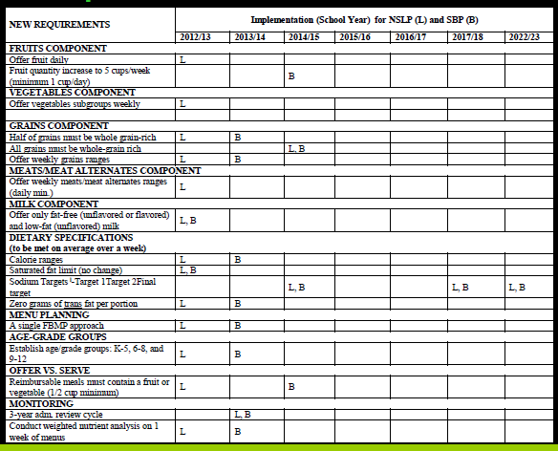
Chart- Implementation Timeline

Slide 32
Breakfast Changes
Effective SY 2012-13
Offer only fat-free (flavored or unflavored) and lowfat (unflavored) milk
Saturated fat limit <10% calories

Slide 33
Lunch Changes
Effective SY 2012-13
Offer fruit daily
Offer vegetable subgroups weekly
Half of grains must be whole grain-rich
Offer weekly grain ranges
Offer weekly meat/meat alternate ranges
Offer only fat-free (flavored or unflavored) and low-fat (unflavored) milk
Calorie ranges

Slide 34
Lunch Changes cont.
Effective SY 2012-13
Saturated fat limit <10% calories
Zero grams of trans fat per portion
Single Food-Based Menu Planning approach
Establish age/grade: K-5, 6-8 and 9-12
Reimbursable meals must contain fruit or vegetable
State agencies conduct weighted nutrient analysis on one week of menus

Slide 35
Breakfast Changes
Effective SY 2013-14
Half of grains must be whole grain-rich
Offer weekly grain ranges
Calorie ranges
Zero grams of trans fat per portion
Single Food-Based Menu Planning approach
Establish age/grade: K-5, 6-8 and 9-12
3-year administrative review cycle
Conduct weighted nutrient analysis on one week of menus

Slide 36
Lunch Changes
Effective SY 2013-14
3-year administrative review cycle

Slide 37
Breakfast Changes
Effective SY 2014-15
Fruit quantity to increase to 5 cups/week (minimum 1 cup/day)
All grains must be whole grain-rich
Target 1 for average weekly sodium limit
Reimbursable meals must contain a fruit or vegetable

Slide 38
Lunch Changes
Effective SY 2014-15
All grains must be whole grain-rich
Target 1 for average weekly sodium limit

Slide 39
Additional
Lunch and Breakfast Changes
SY 2017-2018
  Target 2 sodium restriction
SY 2022-2023
  Final Target sodium restriction
  * Prior to implementation of Target 2 and the Final sodium targets, USDA will evaluate relevant data on sodium intake and human health

Slide 40
Funding
Annual Meal Reimbursement rate will be announced July 2012. Follows CPI-U Food away from home for May
In addition- Schools that meet updated standards will receive additional per meal funding (.06¢)- Lunch only
  USDA guidance to states for administration of .06¢ published at the end of April
  State guidance coming soon
Notes:
Affects PMSI

Slide 41
USDA Foods (Commodities)
USDA sourcing additional products:
  Broccoli
  Beans
  Whole Grains
New Specs for existing products
  Lower sodium cheeses and canned goods
  Fruits packed in light syrup

Slide 42
Other-in the Schools
Must have drinking water accessible at meals
Audits will occur every 3 years (currently 5 years)
  CRE / SMI together
  One week of weighted nutritional analysis
    Sodium, Calories, Saturated Fat and 0g trans Fat
Paid meal pricing equity
Notes:
Affects Customers

Slide 43
Challenges from the New Regs-
Costs- New Nutrition Standards
  Higher cost for purchased foods
  Product Reformulations (Fruits, Vegs, Sodium, Grains)
  Cost of Whole Grain Products
  Cost of Additional Fruit and Veg Servings
  Material changes to contracts
Training- FSD’s, and foodservice staff
Educating kids, parents, administration on NSLP- getting support for new program
Dropping ADP’s because of unfamiliar foods
Timeframe to Implement- product availability

Slide 44
Solutions
Nutrition Education
  Students
  Foodservice Staff
  School Staff, Administration, School Board
  Parents & Community
Program Education
  Foodservice efficiencies (Production- Offer vs. Serve)
Benefits of School Lunch
  Buy in will help maintain ADP’s and control overhead

Slide 45
Opportunities
Teach youth on the benefits of healthy eating and a healthy lifestyle
Use new regulations to improve meal offerings and market to community
Enlist the community and local professionals to help with the initiative

Slide 46

QUESTIONS?

Slide 47

Thank You

